Slide 1
Data modelling for super stars
How to collaboratively design your star schema with end users

Slide 2
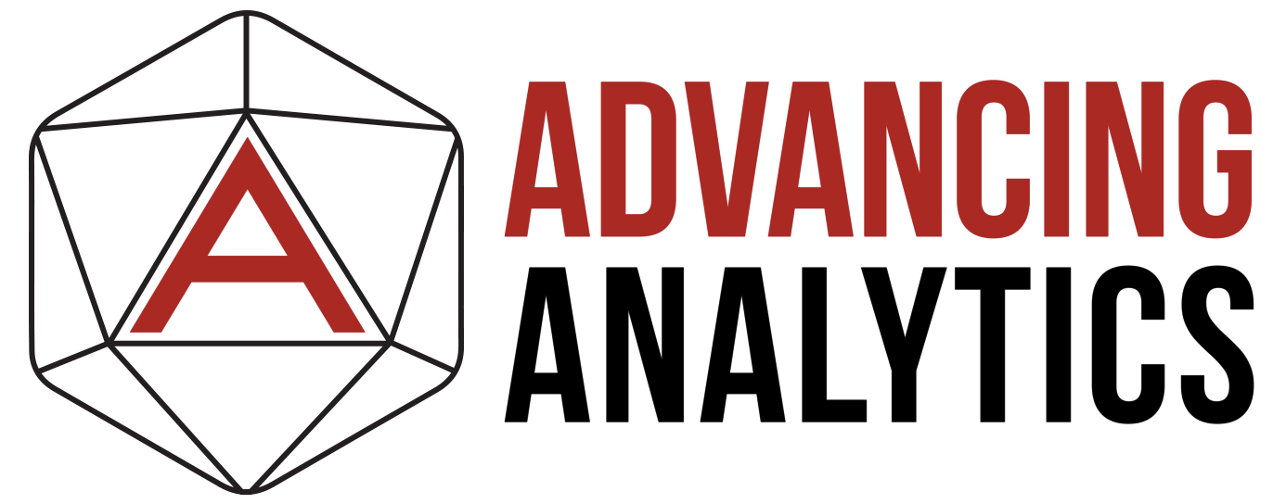

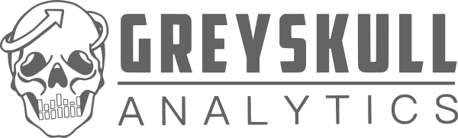

ABOUT JOHNNY (He/HIM)

Slide 3






ABOUT JOHNNY (He/HIM)

Slide 4
Data modelling for super stars
How to collaboratively design your star schema with end users

Slide 5

WHY is this important?
Notes:
For the technologies we work with, the modelling method that we recommend at Greyskull Analytics is a Star Schema.​
​

Slide 6
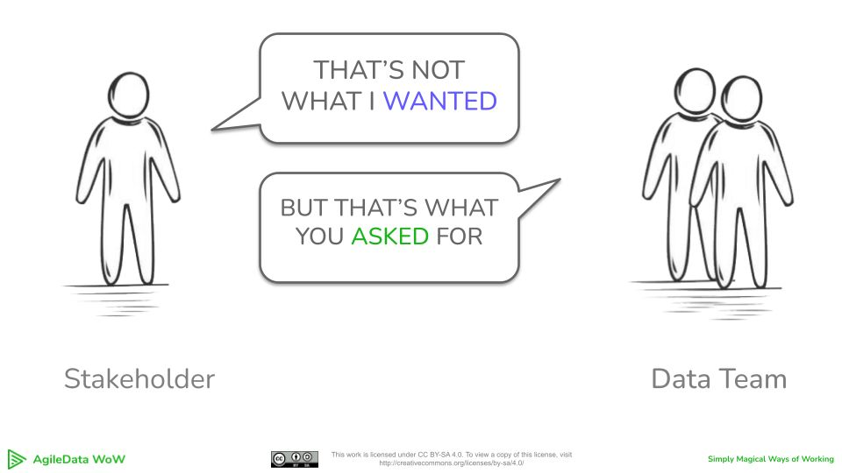
ANYONE FAMILIAR WITH THIS?
Source:
https://www.linkedin.com/posts/shagility_i-have-just-opened-up-the-feb-and-march-cohort-activity-7290207197400047616-G6cO/
Notes:
The problem we face is the disconnect between the developments teams, who are responsible for building the data model and the business users and analysts who will actually use the data platform for doing their analysis.​
​
I've worked with some great developers across many industries who understand the technology and are good are writing code, but often lack the domain knowledge to make sure the data model they develop will meet their users needs.​
​
I've also worked along side end users who understand the way the business operates and know what they want, but find it difficult to communicate this to developers in a way that makes it easy for them to go away and implement this.​

Slide 7
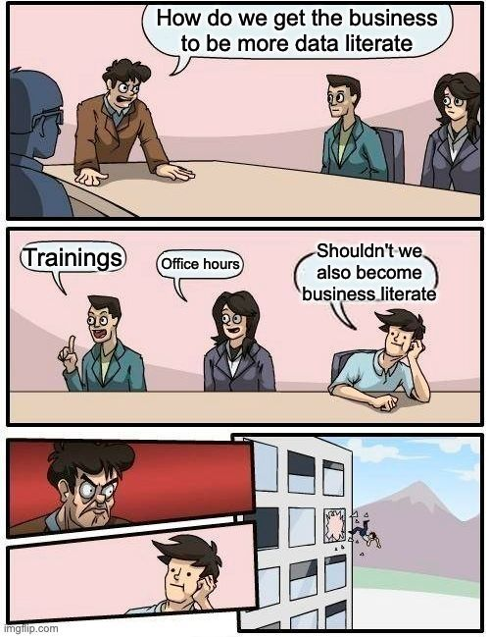
SHOULD DATA PROFESSIONALS TAKE A LOOK AT THEMSELVES?
Source: https://www.linkedin.com/posts/seattle-data-guy_theres-always-been-a-lot-of-talk-about-the-activity-7298867485380907009-hCpJ/

Slide 8

EVERYONE GETTING FRUSTRATED…
Friction leads to
Notes:
That can lead to friction between those 2 parties and ultimately poorly implemented data model, which in a best case scenario leaves you with frustrated business users that struggle to use the platform to fulfil their needs, and in a worst case can means the data platform doesn't get used at all.​
​
What I want to achieve is for you to create well designed star schema that is easy for developers to interpret and therefore easy to implement, and also delivers functionality that makes business users happy and that they want to use, so businesses get full benefit from it, turning you into a data modelling super hero. So I’m here today to walk you through the technique I’ve been using

Slide 9
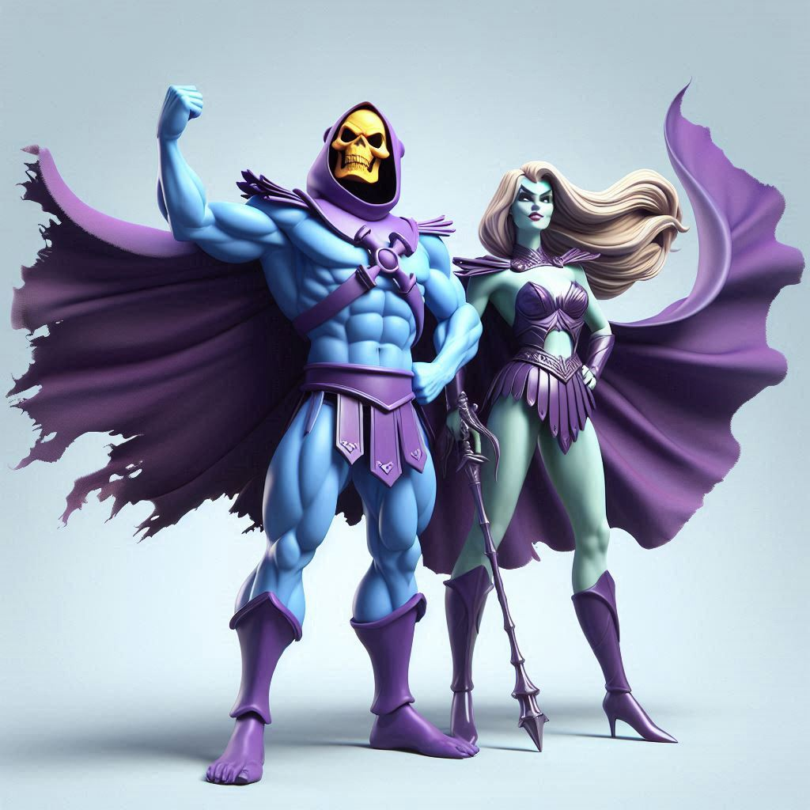
A DATA MODELLING SUPERHERO!
You can become

Slide 10

IS STAR SCHEMA STILL RELEVANT?

Slide 11
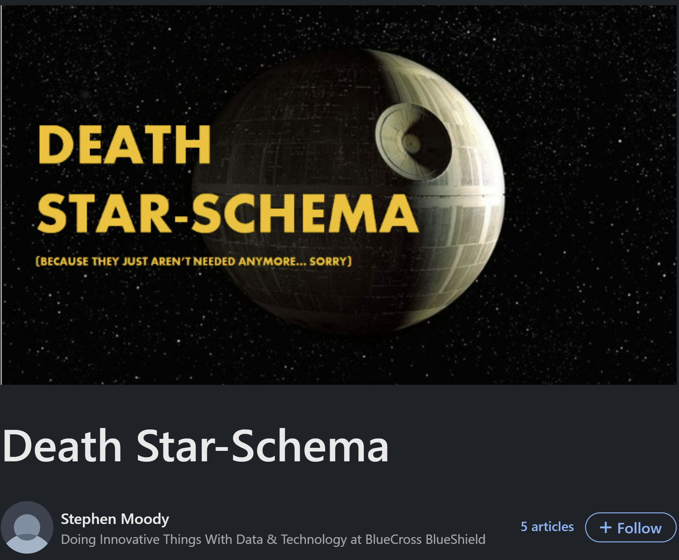
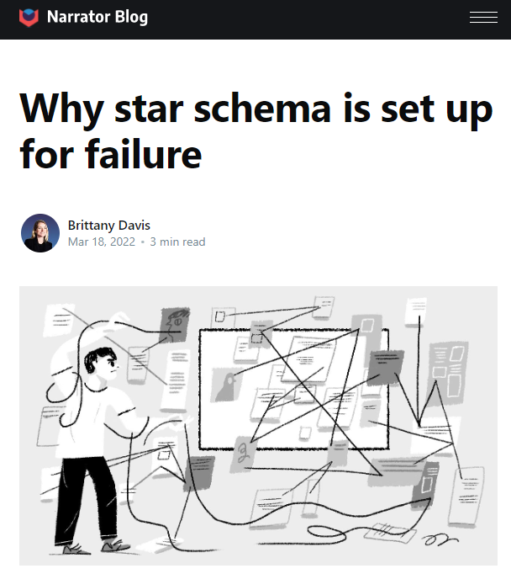
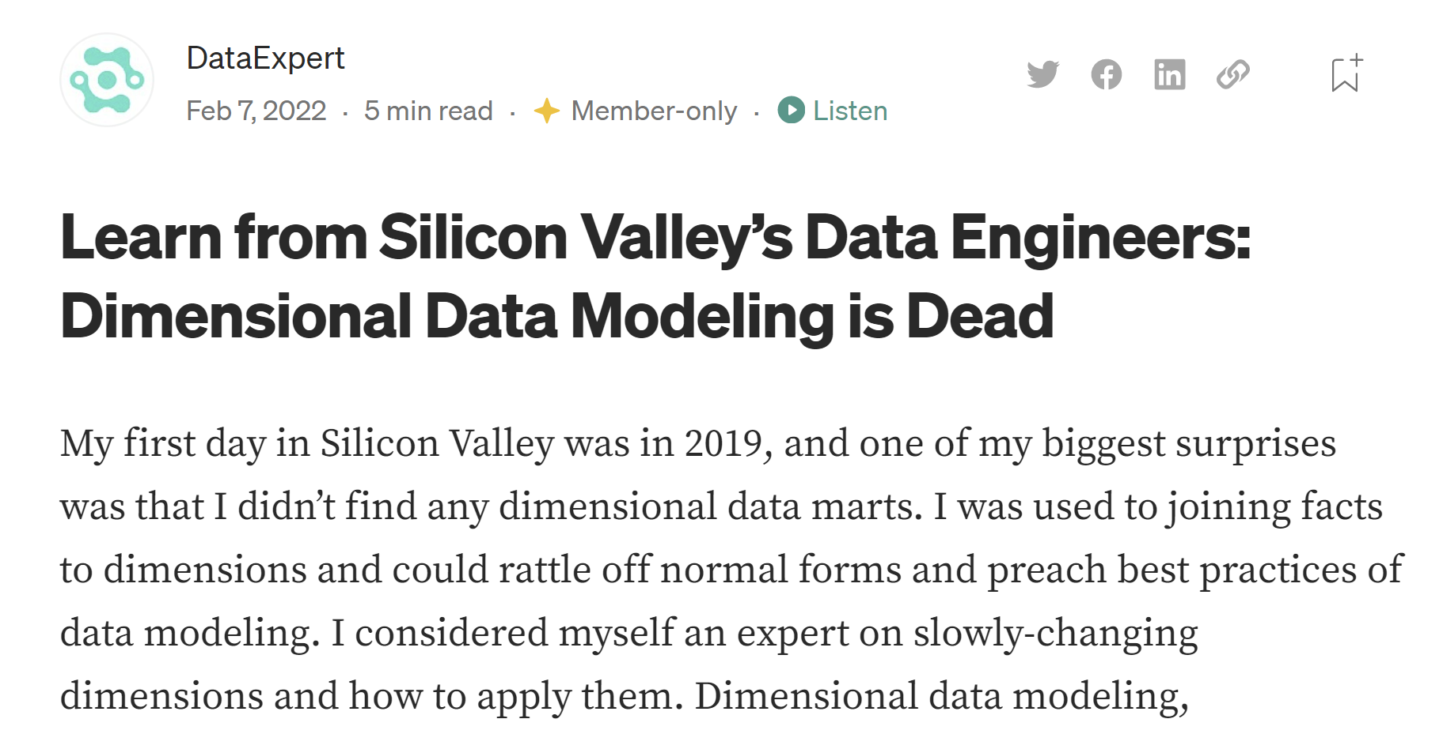
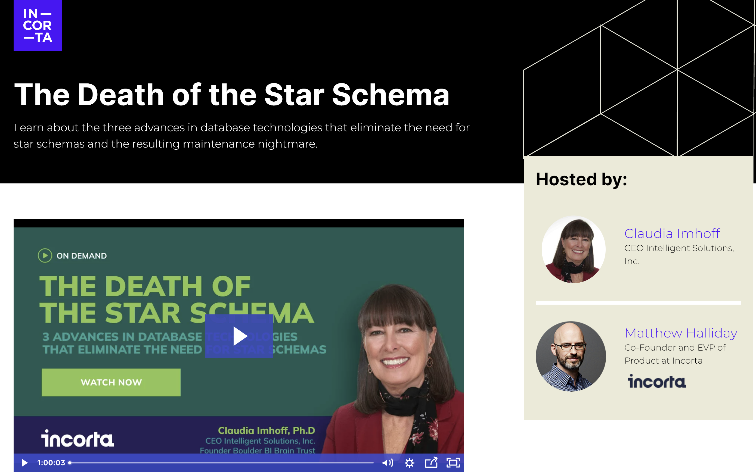

Slide 12
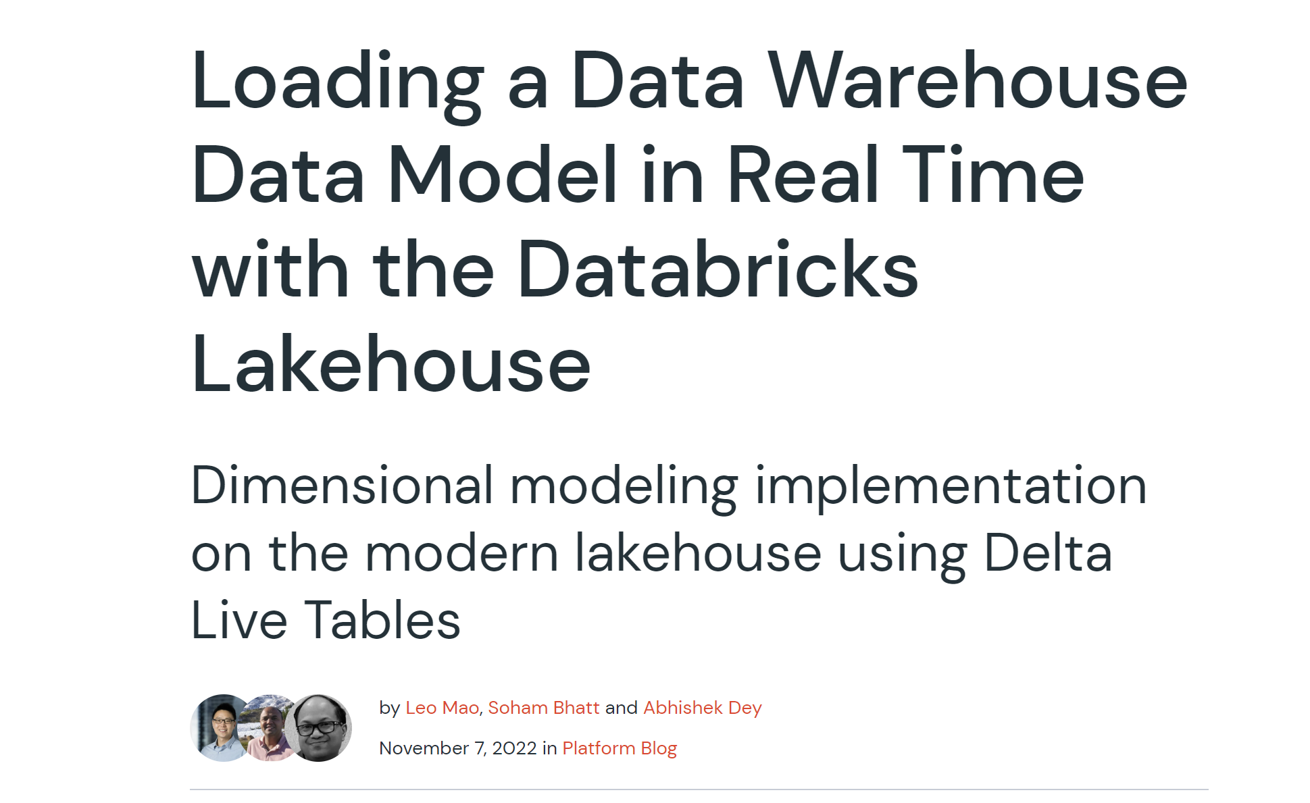
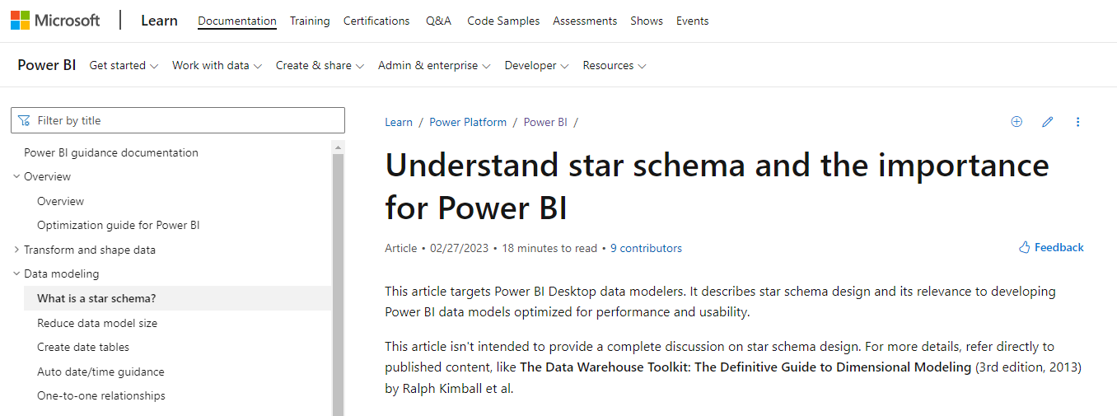
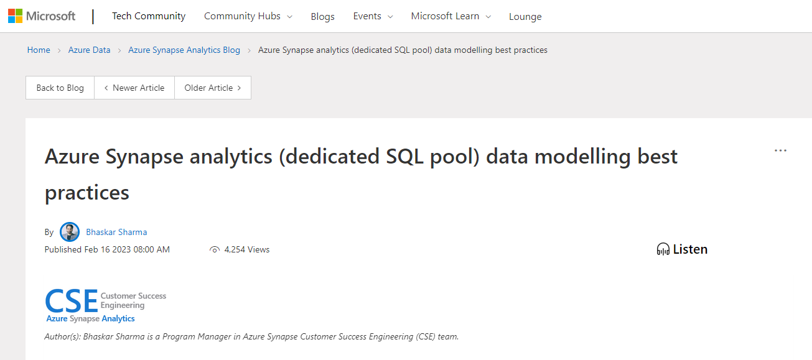
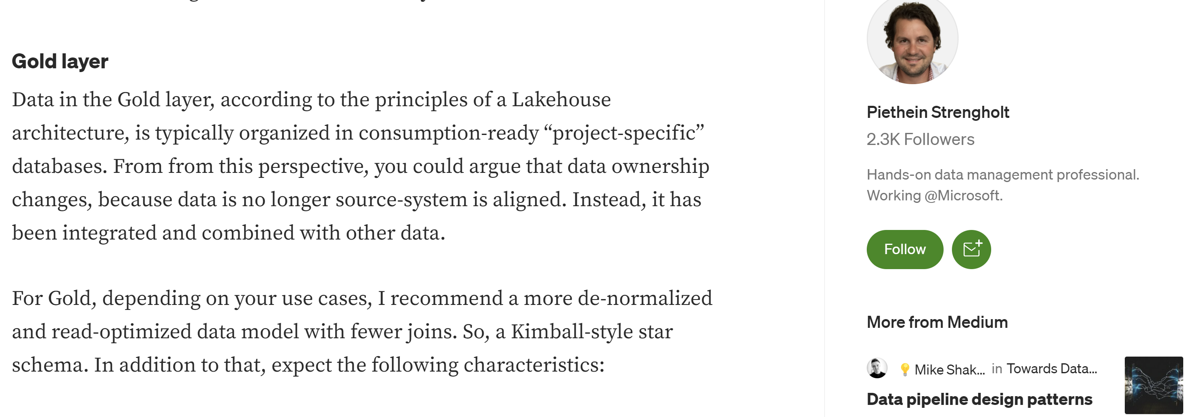

Slide 13
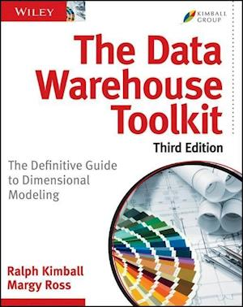
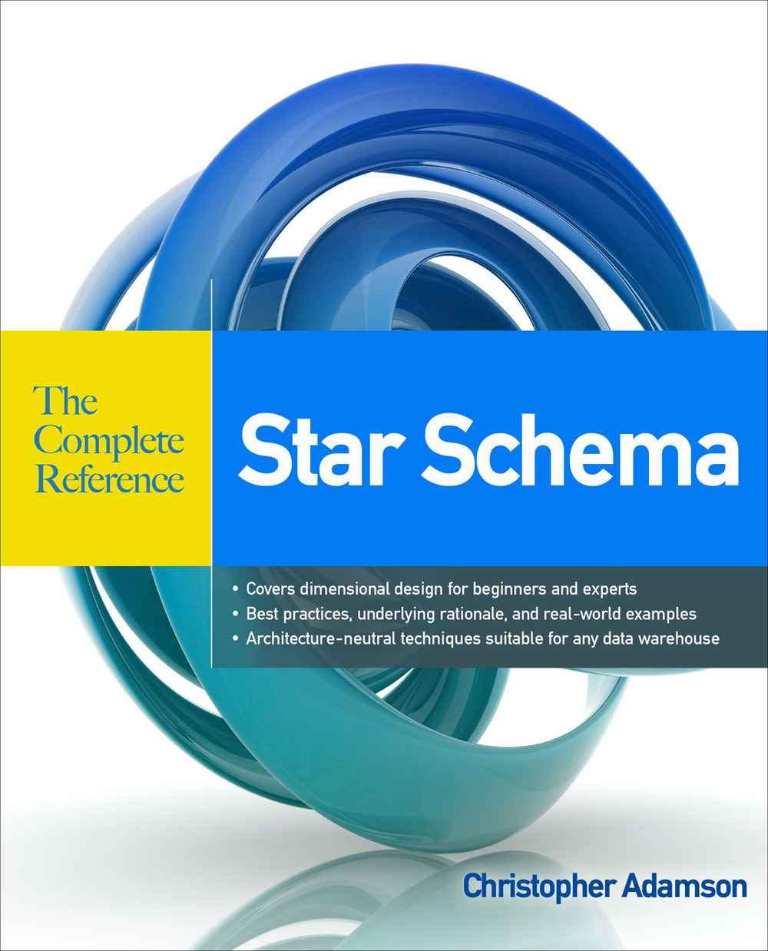
What is a star schema?

Slide 14





Different personas
Developers
Very technical
Can write code
Understand the tech
Business users
Understand the business
Know what they want to see
Not always great at explaining what they need

Slide 15

COLLABORATIVE DATA MODELLING

Slide 16
DATA MODELLING TOOLS & TECHNIQUES
BEAM*
SUN MODELLING

Slide 17
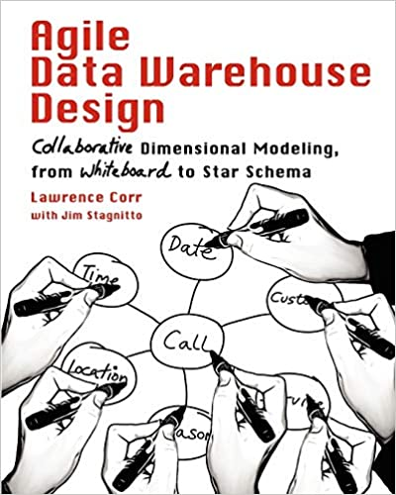
BEAM*
Agile Data Warehouse Design by Lawrence Corr
Business Event Analysis and Modelling
3 Ds
7 Ws

Slide 18
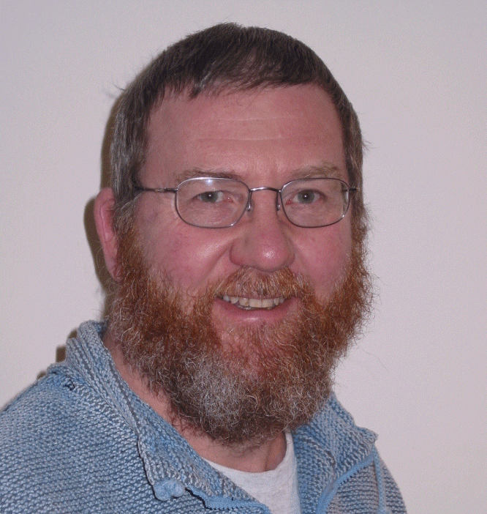
Sun modelling
Word of mouth technique
Advocates of Sun Modelling
Emma Zambonini
Pete Moore
Terry McCann
Mark Whitehorn
Professor of Analytics at the University of Dundee

Slide 19
TYPES OF DATA MODEL
User Model
Conceptual Model
Logical Model

Slide 20


Slide 21
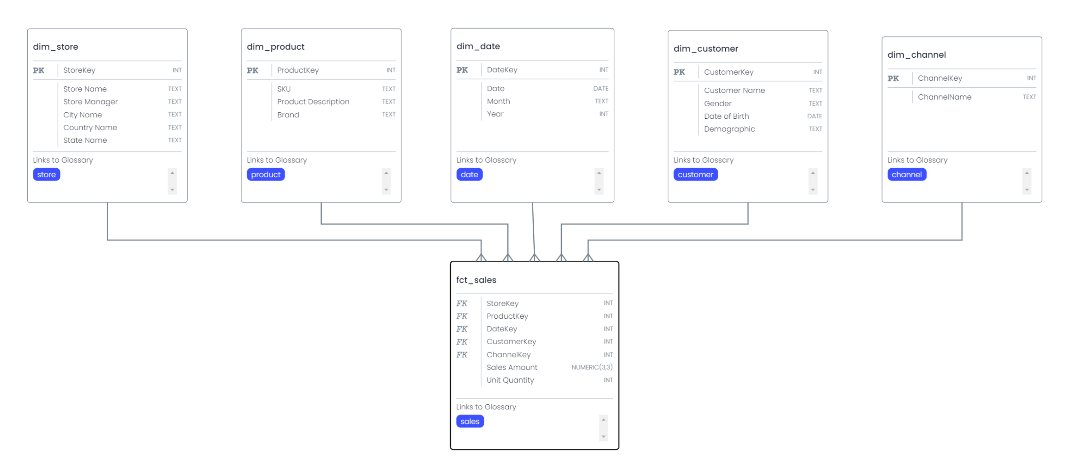
LOGICAL MODEL

Slide 22
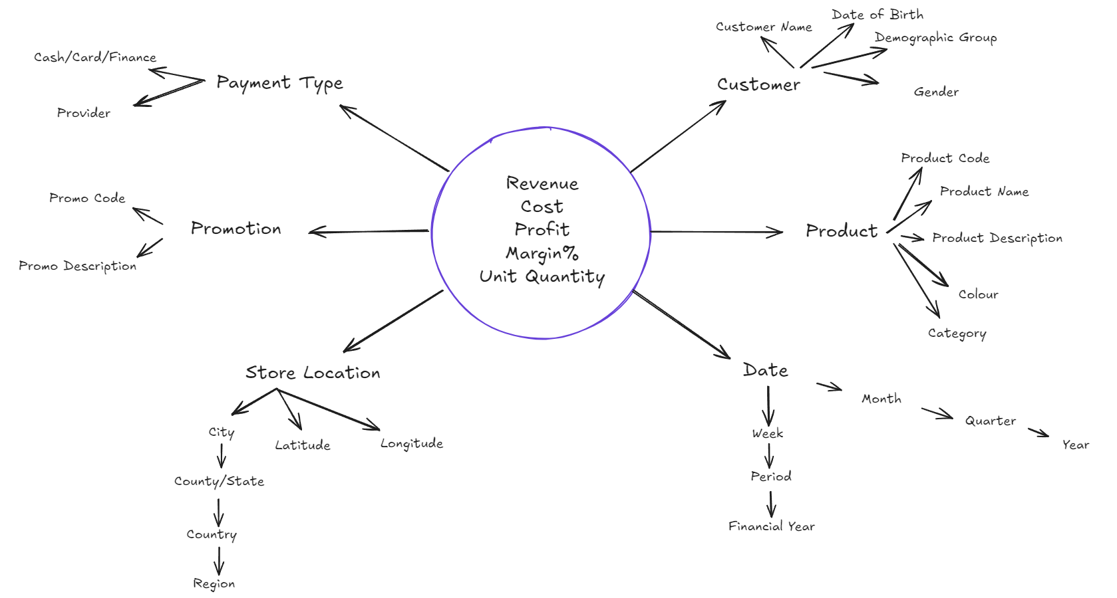
CONCEPTUAL MODEL

Slide 23
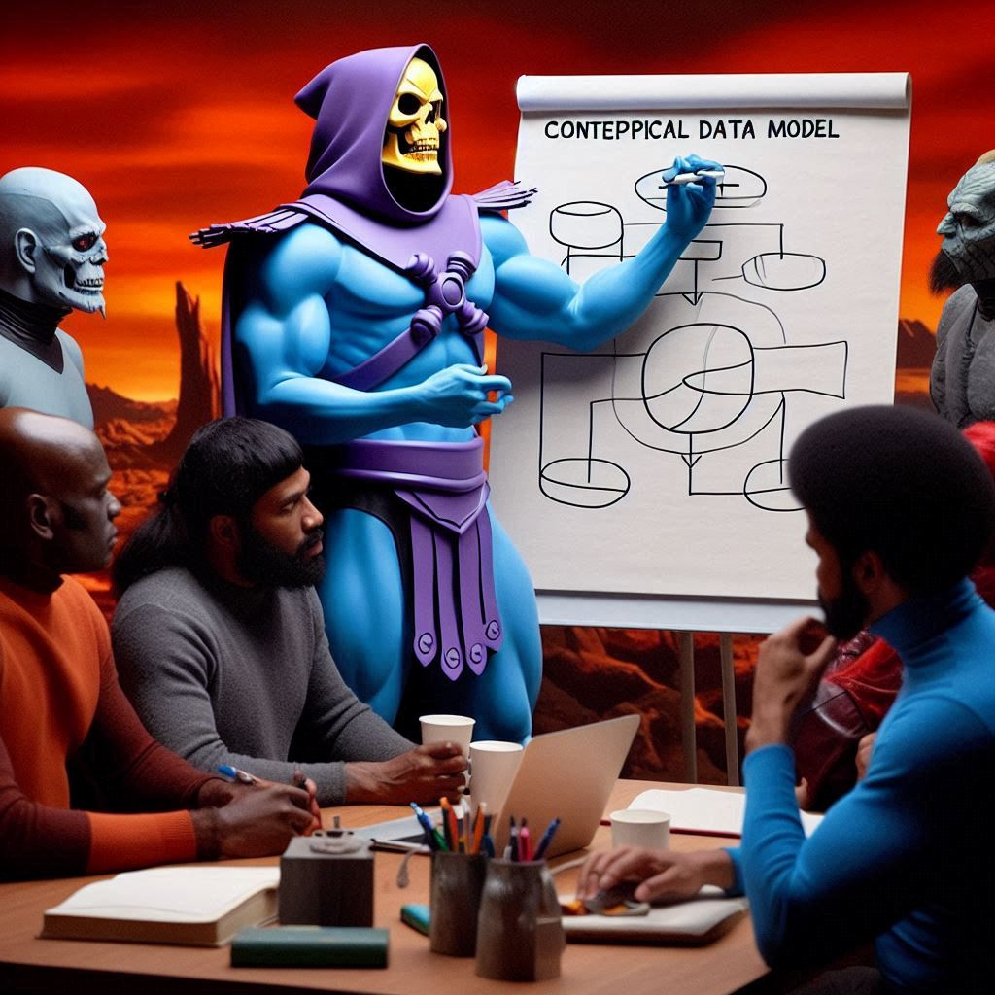
HOSTING A WORKSHOP

Slide 24


DECIDE ON A FORMAT
In person or online?
Miro
Mural

Slide 25

INTRODUCING ELLIE
Collaborative Data Modelling Platform

Slide 26
INVITE THE RIGHT PEOPLE
Get your business users involved​
Good to have 2 people running the workshop. One facilitator, one scribe.​
Choose one business process​
Invite 3-5 people with domain knowledge

Slide 27
The 3 Ds
Discover an event
“Who does what?”
Describe an event
Use the 7 Ws
Document an event
Sun Modelling

Slide 28
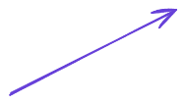


DISCOVER AN EVENT
Who does what?
Customer Buys Product

Slide 29
DESCRIBE AN EVENT
Use the 7 Ws

Slide 30
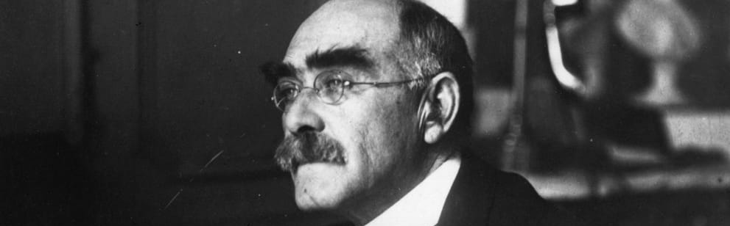
“I keep six honest serving men (they taught me all I knew); Their names are What and Why and When and How and Where and Who”
- Rudyard Kipling

Slide 31
The 7 Ws
Who
What
When
Where
Why
How
How Many

Slide 32
DOCUMENT AN EVENT
Sun Modelling

Slide 33
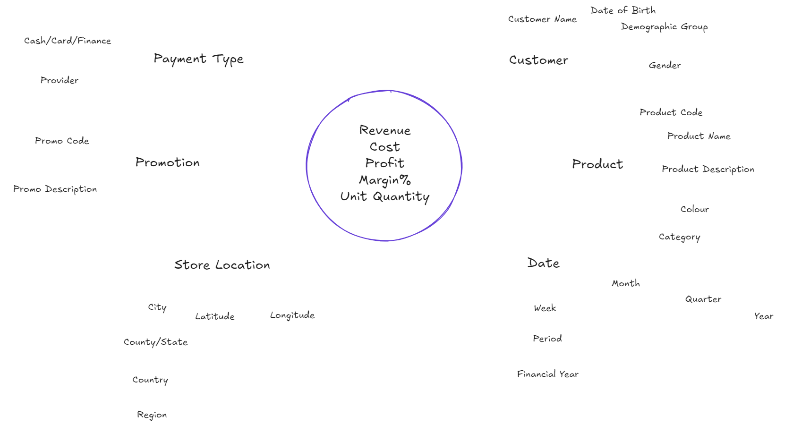
EVENT: Customer BUYS PRODUCT
How Many
Who
What
When
Where
Why
How

Slide 34
EVENT: Customer BUYS PRODUCT
How Many
Who
What
When
Where
Why
How

Slide 35
TIPS AND ADVICE
Ask the 7Ws multiple times – often there is more than one answer​
…but for some Ws there may be no answers​
One sun model per event​
Hold multiple workshops if necessary​
You can do this before data discovery if you like​
Don’t get bogged down in what you already know about your data​
You may wish to use your conceptual model to go away and design a logical model​
But this isn’t the finished/fixed design – it’s a target, but may change during implementation​
You can consolidate multiple sun models into a Bus Matrix

Slide 36
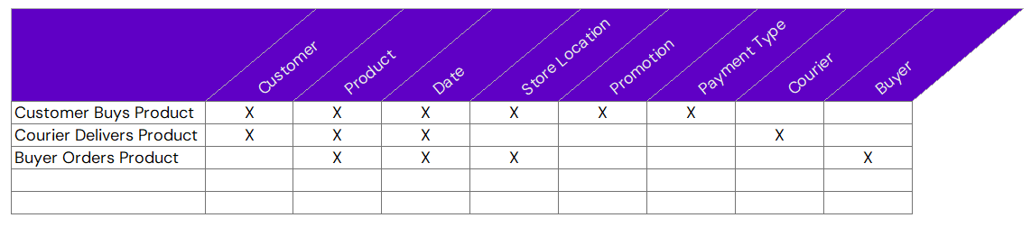
BUS MATRIX

Slide 37

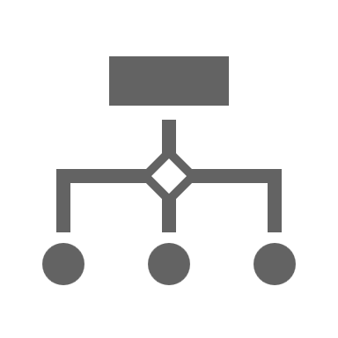
GAPS
Other bits you might want to consider…
Assumes one-to-many relationships.​
Design doesn’t cover things like bridge tables​
Doesn’t cover dimension types.​
This tends to come out during implementation

Slide 38

MAKE IT YOUR OWN!
Use the bits you like…

Slide 39

QUESTIONS?

Slide 40
THANK YOU!
LinkedIn - https://www.linkedin.com/in/j0hnnyw1nter/
BlueSky - @greyskullpbi.bsky.social
Website – https://greyskullanalytics.com/
SubStack – https://greyskullanalytics.substack.com/
Github - https://github.com/GreyskullAnalytics

Slide 41

THANK YOU!

